Slide 1



SOFTWARE DEVELOPMENT PROFESSIONAL PROGRAM
RESTful Routes: New & Create

Slide 2





RESTful Routes: New & Create
Learning Objectives
Define and explain the utility of RESTful routes.
Learn how to create a new item using a form.
Be able to create routes following REST.

Slide 3

RESTful Routes: New & Create
Website Architecture
Imagine you are building a webpage for a school and you need to create pages for all of the cancellations/delays due to snowstorms.
How would you name the routes?
null
Notes:
Give learners a minute to think about it; you may also want to take some
time for suggestions.

Slide 4

RESTful Routes: New & Create
Designing a Website
Possibilities
/January-Events/20/2019/Snow
/Snowstorms/Cancellations/Tomorrow
/Info/Events/Important/Inclement-Weather

Slide 5
RESTful Routes: New & Create
Choosing Routes
Let's Add More Weather Events
December 8, 2019: Early dismissal
February 3, 2020: Half-day
May 4, 2018: Windstorm/county power outage
Notes:
Give learners a minute to try to figure out how they would organize the website.
The takeaway is that there are many possibilities and it is challenging to come up with a good strategy.
Managing on your own can be cumbersome, frustrating, and you can face unexpected problems with your own design.

Slide 6
RESTful Routes: New & Create
RESTful Routes
RESTful Routes
Utilizes HTTP verbs to keep unique paths to a minimum
Creates an easily understandable and maintainable pattern
Provides flexibility, while limiting unique routes
Notes:
Since this is such a common problem and one that many engineers have faced, someone(s) came up with
an excellent pattern that has stood the test of time.

Slide 7
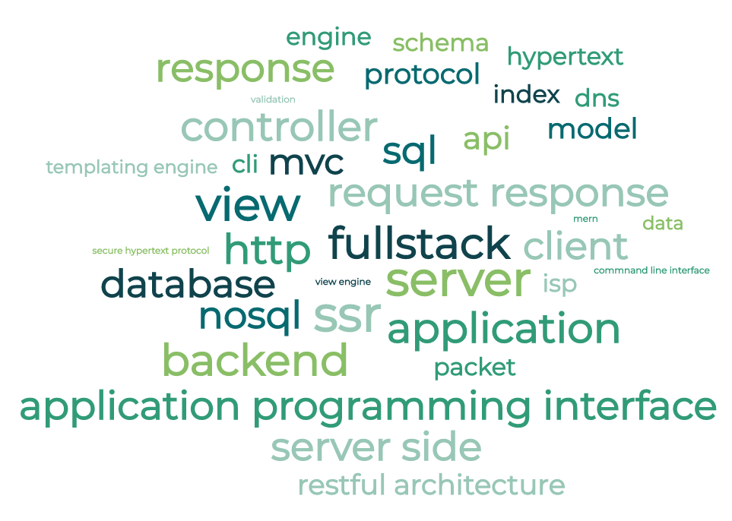
RESTful Routes: New & Create
Jargon Time
REST
Representational
State
Transfer
Wordcloud generator by monkeylearn
Notes:
This is what it stands for, but it is not useful to the learners at this point.
The next slide will demonstrate what learners should focus on learning and understanding.
Learners who want to learn more can visit https://en.wikipedia.org/wiki/Representational_state_transfer
This link will be provided as a bonus activity in the next activity block.

Slide 8
RESTful Routes: New & Create
A Practical Definition
Action | HTTP METHOD | Example Route
INDEX | GET | /breads
SHOW | GET | /breads/:id
CREATE | POST | /breads
NEW | GET | /breads/new
EDIT | GET | /breads/:id/edit
UPDATE | PUT | /breads/:id
DESTROY | DELETE | /breads/:id
REST: A pattern for creating webpages that allows users to perform CRUD
Notes:
The Seven. We'll break them down and revisit them often throughout the rest of the unit.

Slide 9
RESTful Routes: New & Create
BreadCRUD: Index & Show
We have been building our app with RESTful routes.
Action | HTTP METHOD | Example Route | View | Description
INDEX | GET | /breads | index.jsx | A list of all the breads
SHOW | GET | /breads/:id | show.jsx | A detailed view of one bread
Notes:
These are the routes we've created so far.

Slide 10
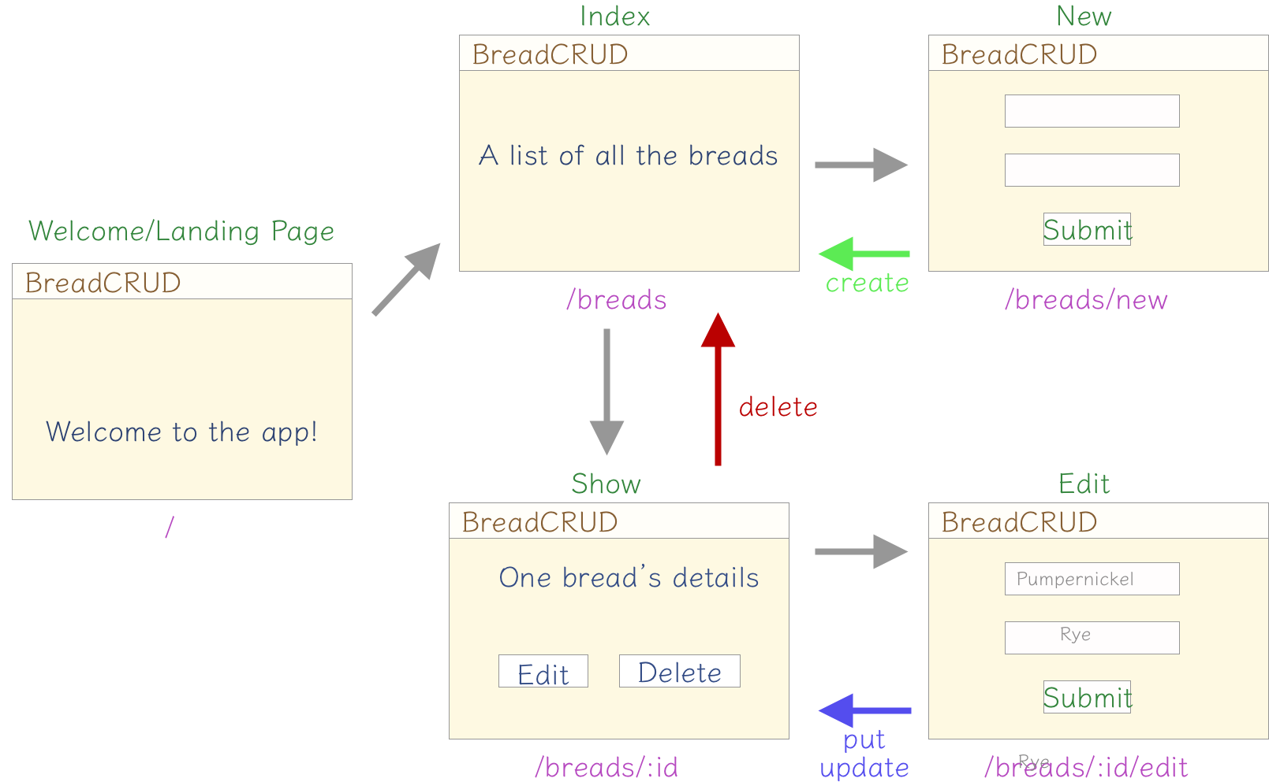
RESTful Routes: New & Create
BreadCRUD Views & Routes
null
Notes:
The landing page is a purposeful view that is not one of the seven RESTful routes.
That's okay! Not every route will fit.
Review with learners that we have done index and show.
Point out that we are now going to do New & Create.

Slide 11
RESTful Routes: New & Create
BreadCRUD: New & Create
Let's add the ability to create a new bread.
Action | HTTP METHOD | Example Route | View | Description
NEW | GET | /breads/new | new.jsx | A form to make a new bread
CREATE | POST | /breads | none | The route that creates a new bread in our database and redirects to another view
Notes:
These are the routes we'll build today.

